Slide 1
Technikum Komunikacyjne No. 25
Named after
St. Rafał Kalinowski

Slide 2
The history of the school
1945/1950: Technikum Ekonomiczno-Kolejowe (Economic-railway college) - Basztowa 9
- 3 Profiles: Finances in railways, Railway statistics, Planning in railroad transport 01.09.1969: Technikum Kolejowe receives new building complex located at Ułanów 3, near former airbase.
- Most advanced school made for teaching railway technicians in Poland -
Most advanced laboratories within the school in Poland included: Security automation of railway transport, Teletransmission and Telecommunication labs

Slide 3
Technikum Komunikacyjne (Communications college)
2002: Railway traditions are overtaken by the newly established “Technikum Komunikacyjne” (Communications college)
Technician profiles: Telecommunications, informatics, electronics, electricians, mechanics, logistics, vehicles, programming

Slide 4
Technikum Komunikacyjne (Communications college)
2016/17: 800 students in 33 classes, attending profiles: Informatics, electronics, vehicles, logistics, railway transport, mechatronics
106 Teachers, 22 administration workers, mgr. Beata Śliwa claims the title of the current principal

Slide 5
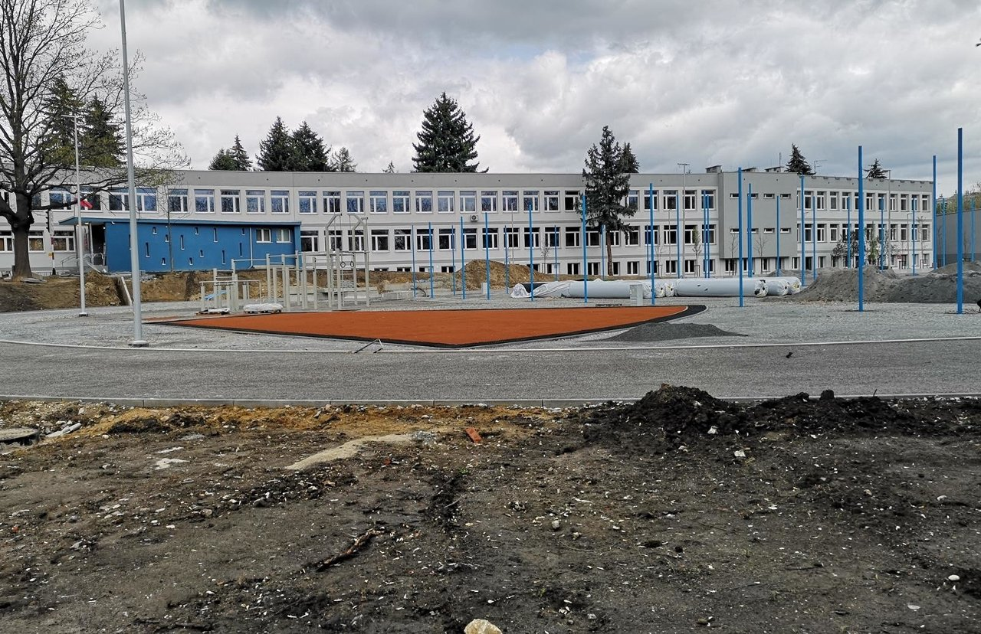
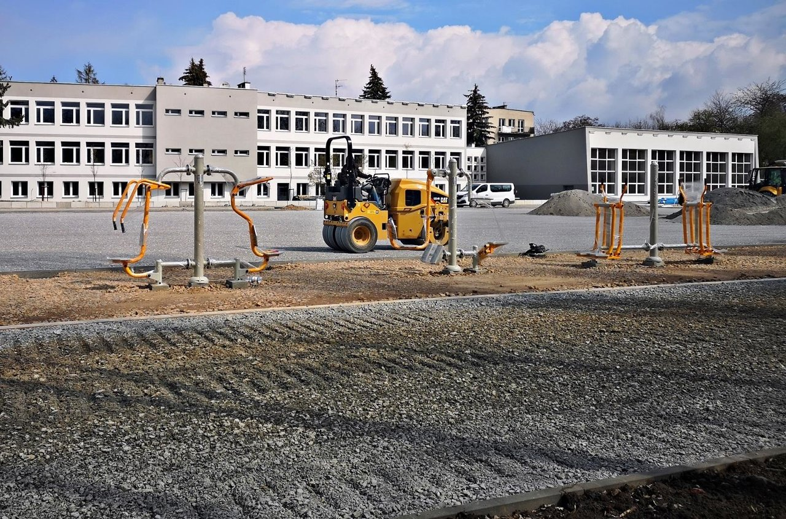
New sports and recreation complex
On September 1st, the Mayor of Krakow, Jacek Majchrowski, opened the largest sports and recreation complex at the School Complex No. 1 (3 Ułanów Street). This is another Krakow educational facility, which is now a new complex, allowing students to pursue their alternative passions. The cost of the investment amounted to 5,649,900.26 PLN gross, fully funded by the budget of the City of Krakow.

Slide 7
Charity Events organized at our school :
Collecting food and goods for animal shelters in winter
donating blood
collecting money for ppor children

Slide 8
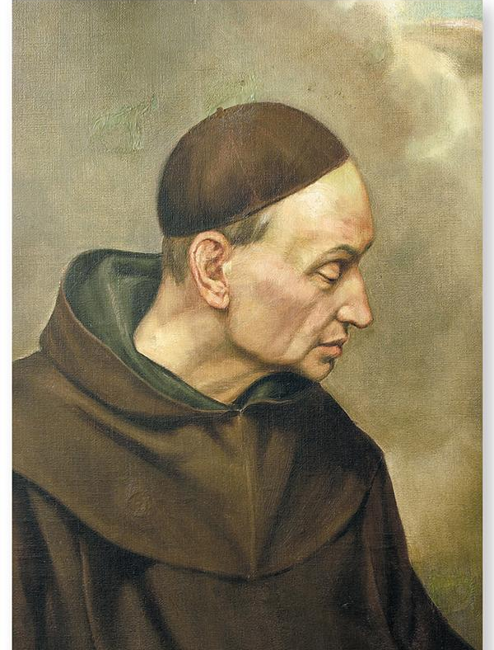
Saint patron of the School
On November 22, 2005, a significant event took place in the history of the school with the official announcement that St. Raphael Kalinowski becomes the patron of School Complex No. 1 in Krakow, as well as the presentation of the school's new flag.

Slide 9
Some information about the Patron of the school:
Clergyman,
one of the best students in the history of the Noble Institute in Vilnius.
A teacher of mathematics, physics, geography, Polish literature, and Christian philosophy.
Engineer and railway builder.
Tutor of mathematics and construction mechanics.

Slide 10
Notable graduates of our school
Tadeusz Gawin (graduated in 1970, major in Railway Telecommunications) – Member of the Polish Parliament (Sejm) during the second term.
Jerzy Hołoweńko (graduated in 1986, major in Railway Roads and Bridges) – athlete, decathlete, indoor Polish champion, and representative of Poland.
Mariusz Jakus – actor, lecturer at the Leon Schiller National Film, Television and Theatre School in Łódź.
Zdzisław Kapka – football player, played for clubs including Wisła Kraków, World Championship medalist in 1974.
Anna Mąka (graduated in 1968, major in Railway Traffic Control Devices) – luge athlete, participant in the 1968 Olympic Games in Grenoble.
Szymon Sowiński – world record holder in air pistol shooting (2017), silver medalist at the Paralympic Games (Tokyo 2020).

Slide 11
Made by
Olaf Trojan
Karol Wąchol
Kacper Strzlecki
Jakub Śmiałek
Tomasz Szczęsny
Class 5IA

